Slide 1

Smart Home IoT Devices
By Kenzie, Marcel, Jon, & Omar
EEET-313 Communication Electronics Group 4

Slide 2
A brief Overview
Smart home devices emerged prominently in the late 2010s with products like Amazon's Echo and Google Home.
IoT and smart home devices have transformed modern society by making homes more comfortable, efficient, and secure.
They allow automation and control of household functions, provide energy efficiency, and offer accessibility for the elderly or those with disabilities.
IoT has applications in various sectors beyond the home, including healthcare, transportation, agriculture, significantly impacting modern society.
The Internet of Things (IoT) is a network of physical devices connected through the internet, allowing data collection and exchange.
The term IoT was coined by Kevin Ashton in 1999, but it wasn't until the mid-2000s that it started to become a reality with the proliferation of wireless technology.
Smart home devices are IoT consumer products that can be controlled via smartphones or computers, including thermostats, security systems, lights, appliances.

Slide 3
History of Iot/smart home devices
Early Beginnings (1898-1975):
Introduction of remote controls by Nikola Tesla.
Debut of home appliances and X10 home automation platform.
Late 20th Century to Early 2000s:
Creation of the first IoT device in 1990.
Advent of broadband, Wi-Fi, and 3G facilitating smart home technologies.
Mid to Late 2000s:
Enhanced internet speeds with 4G in 2009, promoting mobile control of smart devices.
2010s:
Release of Amazon Echo in 2014, pioneering voice-controlled smart home devices.
Standards Development:
Emergence of Zigbee, Z-Wave, and Thread protocols improving interoperability and security
Challenges and Solutions:
Addressing security concerns, standardization, and mesh network implementation for better connectivity.

Slide 4
Stakeholders in IoT/Smart Home Ecosystem
Major Stakeholders:
Tech Giants: Apple, Google, Amazon
Technology Investors, Developers, and Integrators
Open Standards:
Zigbee (Philips Hue, Logitech, LG, Samsung)
Z-Wave (Honeywell, GE, Samsung)
Matter/Thread (Apple, Google, Nanoleaf) - hub-less mesh network
Wired Technology Stakeholders:
Control4, KNX, Loxone
Trend & Future Outlook:
Transition from proprietary to open standards for better interoperability.
Anticipated increased collaboration for seamless integration and enhanced security.

Slide 5
Societal Impacts (Notable Incidents & Future Impacts)
Notable Incidents:
Amazon Account Lock: Misinterpreted doorbell greeting led to a customer's smart home access being revoked.
Eufy Security Claims: False encryption claims exposed, revealing unauthorized cloud footage upload.
Amazon Ring Sharing: Video access shared with police without user consent multiple times.
Chicago: Most surveilled city in the nation, allows residents to link security cameras into OEMC private sector camera initiative.
Future Societal Impacts:
Privacy Concerns: Ongoing security issues could exacerbate privacy concerns, potentially leading to stricter regulations. Foreign actors providing services can retract them, locking consumers out.
Data Management: Re-evaluation of smart home device usage and data management practices may occur.

Slide 6
Societal Impacts(Positives Vs. Negatives)
Positives of IoT/Smart Home Devices:
Convenience: The ability to control various aspects of your home remotely or through automated systems provides significant convenience.
Safety: Devices like anti-burglar systems, baby monitors, and fall detectors enhance home safety.
Efficiency: Smart devices can manage energy use more efficiently, leading to cost savings.
Accessibility: For the elderly or disabled, smart home devices can make managing a home easier.
Negatives of IoT/Smart Home Devices:
Security Breaches: IoT devices can be vulnerable to hacks, potentially allowing unauthorized access to private information or control over devices.
Dependence: Over-reliance on technology could lead to problems if systems fail or access is lost. The devices being dependent on servers and apps can be used to artificially limit their lifespans
Privacy Concerns: Devices that collect and transmit data, such as security cameras or voice-controlled devices, could be used to infringe on privacy.
Inequality: Access to and the ability to use smart home devices may widen the digital divide, with those unable to afford or use such devices potentially disadvantaged.

Slide 7
Technical Operation of the System
Smart Home Technologies
Emerging Protocols
Smart-Hub Based Systems:
Zigbee & Zwave: Mesh network protocols, sub-1GHz frequency for Zwave, 2.4GHz for Zigbee, require a hub.
Lutron: Proprietary Clear Connect tech, operates sub-1GHz, utilizes its own bridge.
Philips Hue: Uses Zigbee, newer models support Bluetooth.
Wi-Fi & Ethernet:
Standard Wi-Fi: Common, suitable for non-battery-powered devices, operates on 2.4GHz or 5GHz.
Ethernet: Utilized by Matter-supporting devices, reliable, wired.
Matter/Thread:
Matter: New standard for unifying smart home devices, supports Ethernet.
Thread: Low-power, mesh networking with IPv6, enhances scalability.
Apple HomeKit:
Framework for smart home control within Apple ecosystem, supports Wi-Fi, Bluetooth, and via bridges, Zigbee, and Zwave. HomePod speakers and AppleTV’s are matter controllers

Slide 8
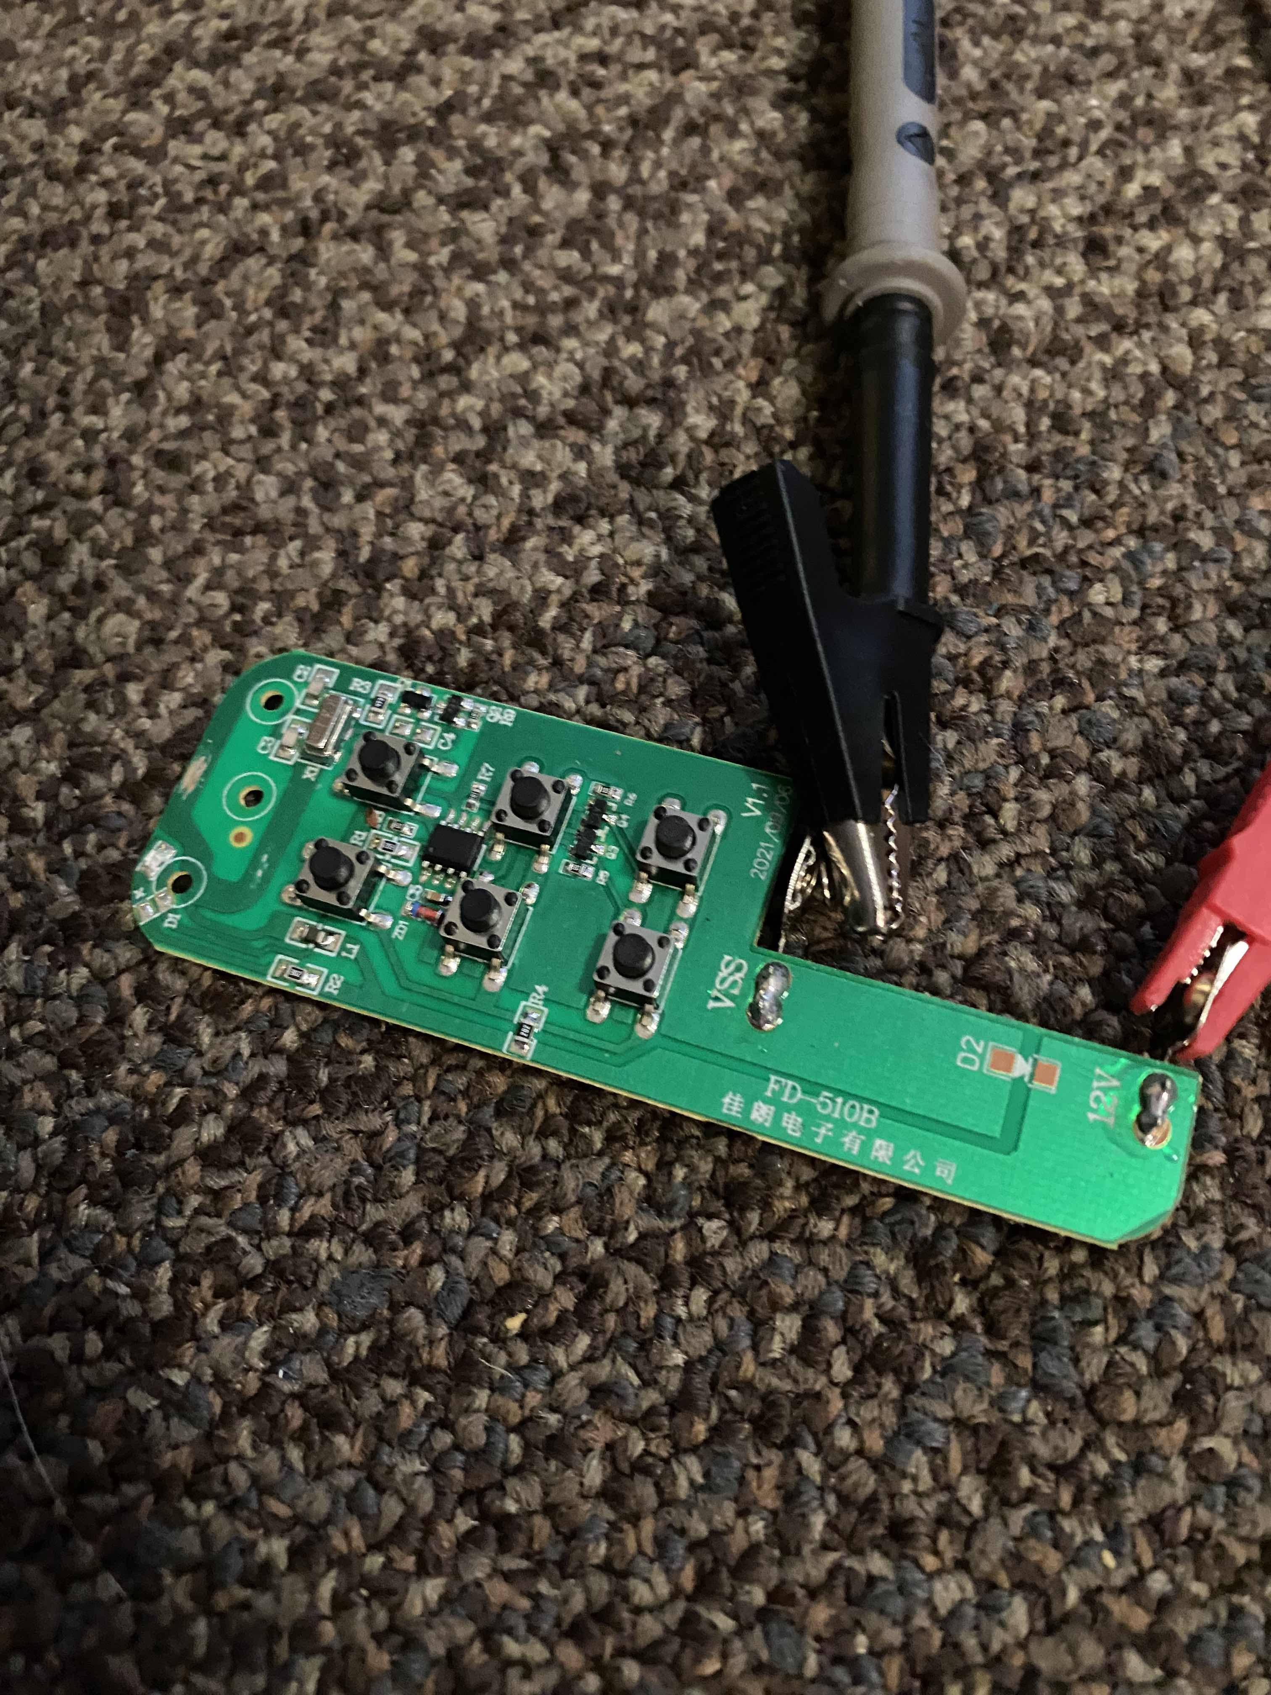
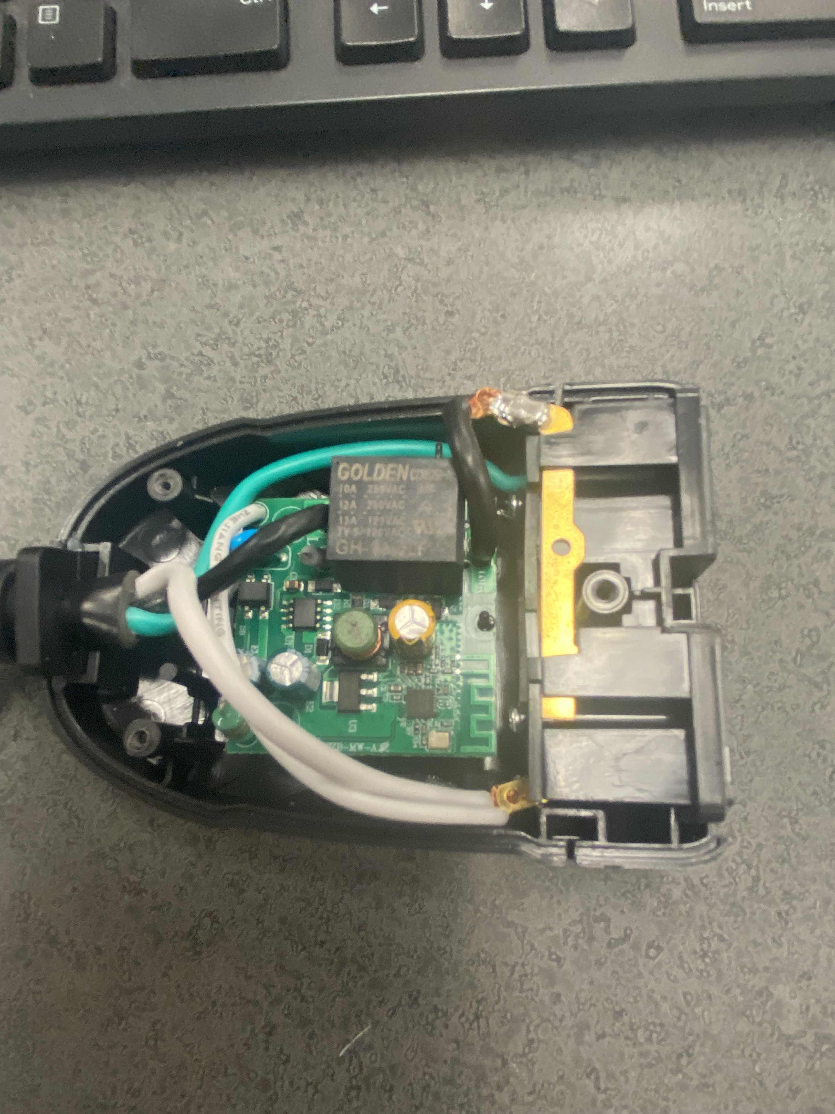
Demonstration/analysis
Above left: Basic 315MHz light remote. Wireless but not ‘smart’.
Above right: cheap smart outlet, runs on Wi-Fi. Not weatherproof, like it claims

Slide 9

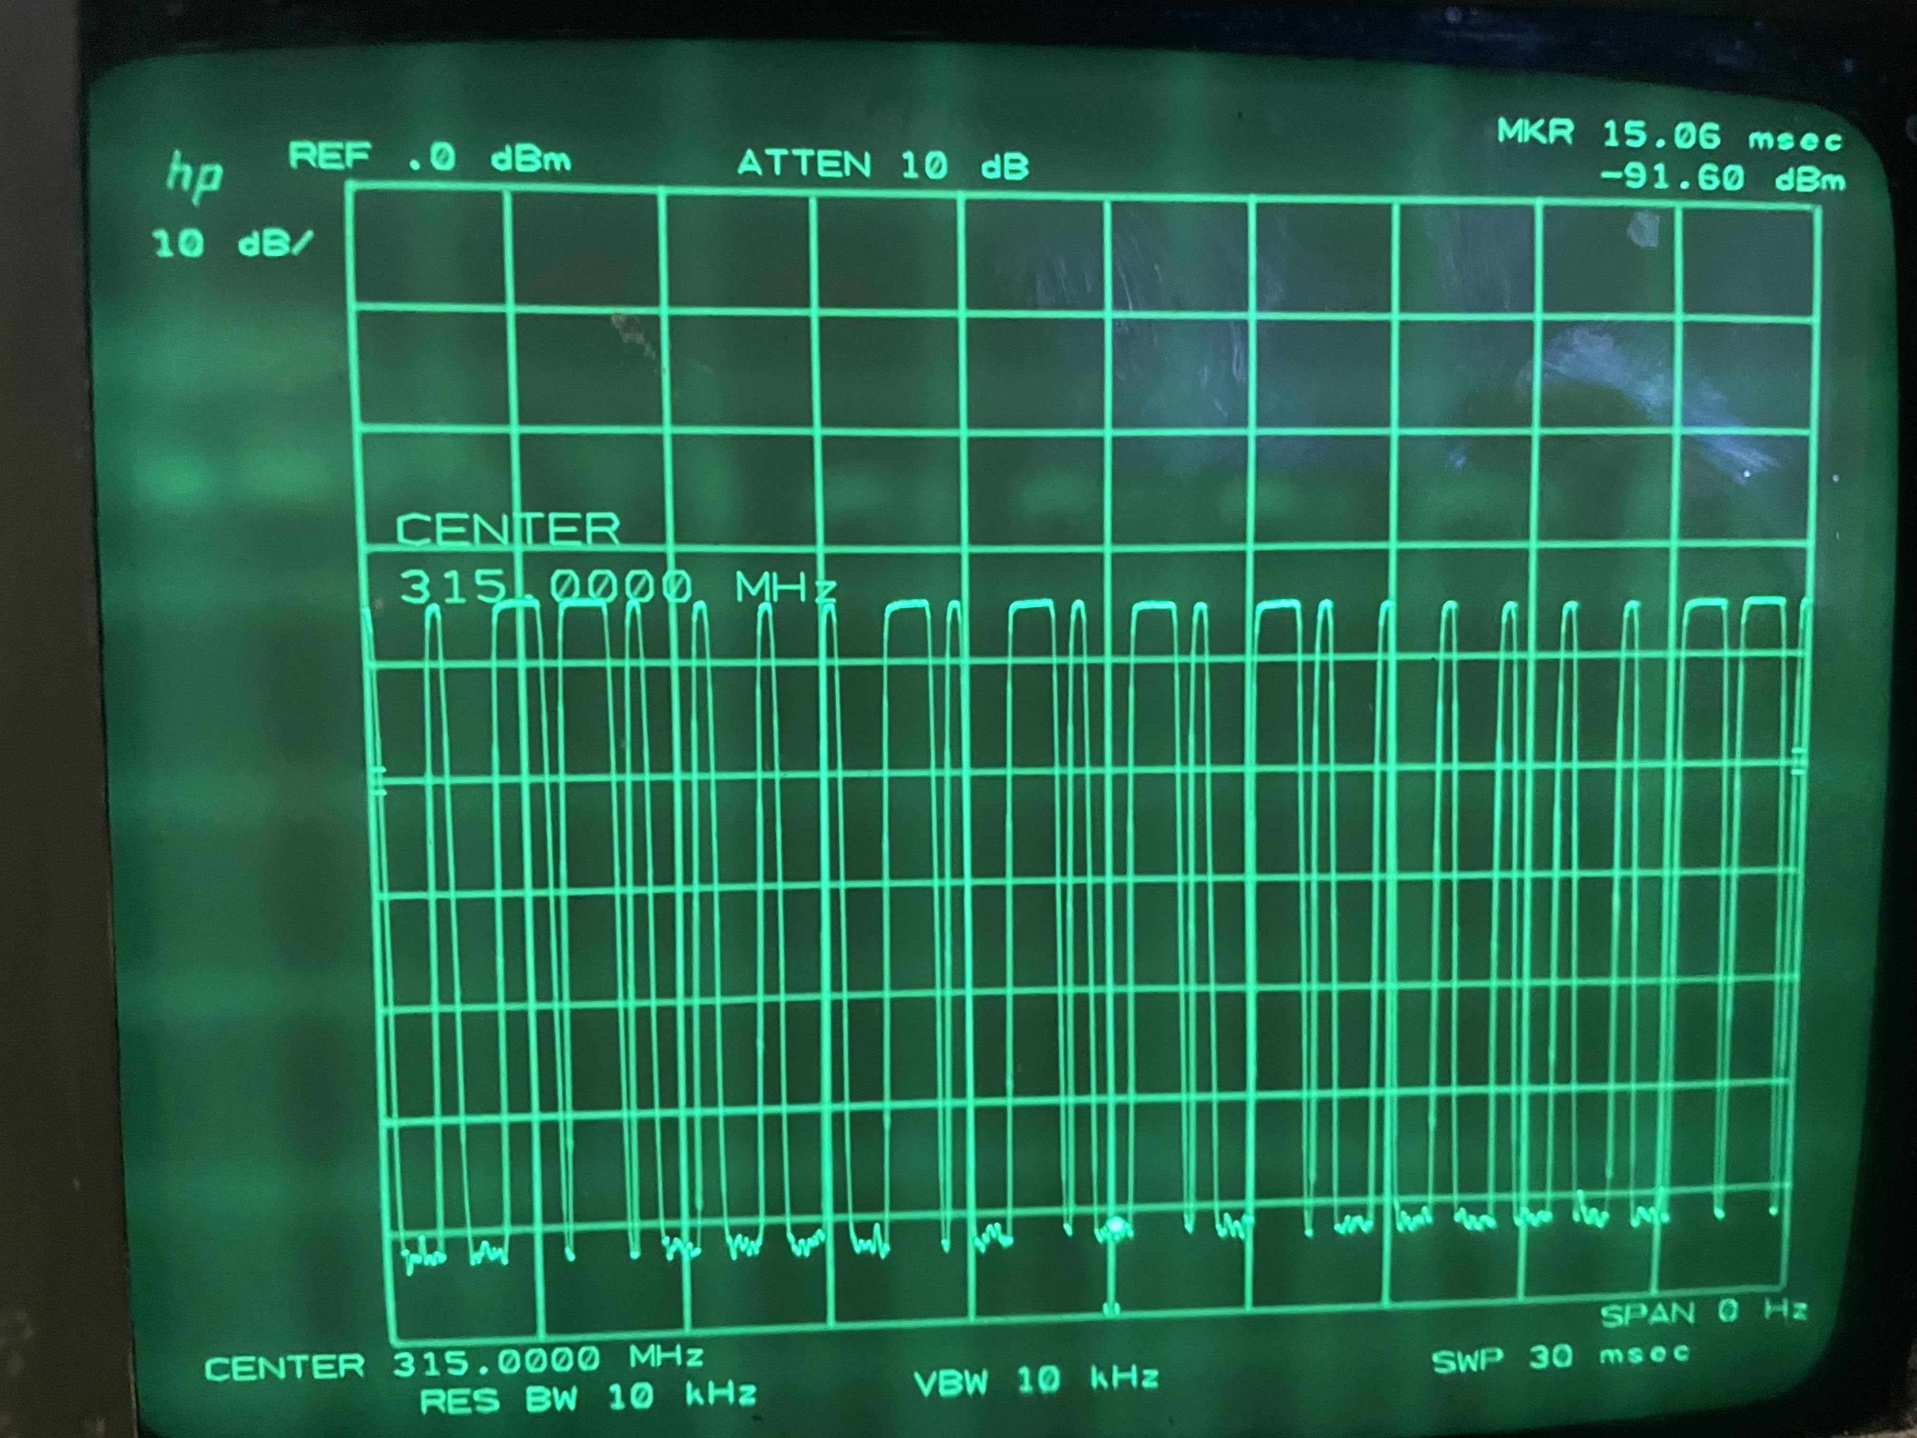
Demonstration/analysis(cont.)
Above left: SEXY HP Spectrum Analyzer, showing wireless communications
Above right: Analyzer showing remote transmitting

Slide 10
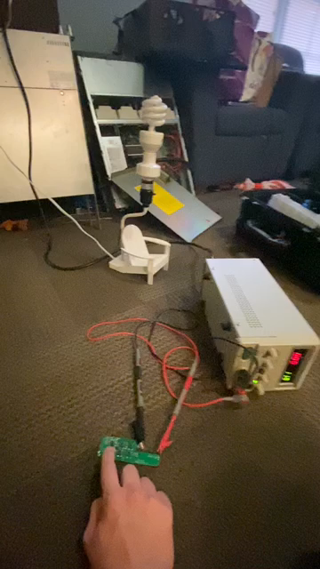
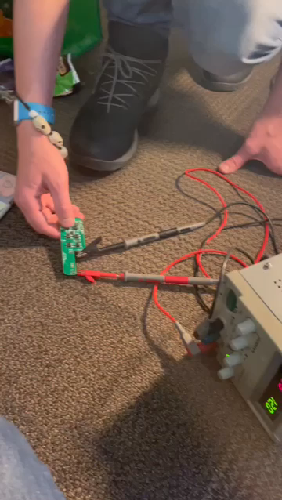
Demonstration/analysis(cont.)
Above left: Showing operation of simple remote control
Above right: Listening to remote

Slide 11

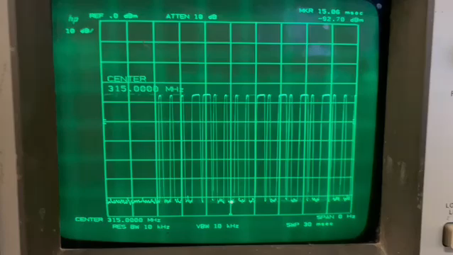
Demonstration/analysis(cont.)
Above right: Showing packet bursts from remote.
Above left: Showing remote transmission on waterfall at 315 MHz

Slide 12
reflection

Slide 13
IoT/Smart Home Software & UI Options
Home Assistant:
Open-Source: Widely compatible; powerful customization.
Server Requirement: Needs server computer (e.g., old PC, Raspberry Pi).
Local & Secure: No monthly fee; operates locally on your network.
Community Support: Large community sharing "blueprints" for setups.
Other Platforms (Google Home, Apple HomeKit, Alexa):
Ease of Use: User-friendly but often requires a subscription fee due to cloud-based services. Often requires remote server for simple tasks, in exchange for outside-the-house control.
Cross-Platform Integration: Home Assistant links devices/services from different ecosystems together.
Considerations:
Learning Curve: Self-hosted solutions require learning programming and server management.
Monthly Fee Avoidance: Opt for self-hosted solutions like Home Assistant to avoid recurring costs.

Slide 14
Conclusion
Bridging The Present and The Future:
Evolution: Transition from Tesla's remotes to today's versatile smart homes.
Stakeholder Collaboration: Tech giants and developers driving innovation, enhancing interoperability and security.
Societal Impacts: Balancing benefits like convenience, safety with challenges like privacy and security concerns.
Technical Operation: Networking protocols and software platforms underpinning functionality and user experiences.
User-Centric Approach: Platforms like Home Assistant empowering user control, security without monthly fees.
Future Outlook: Movement towards open standards, improved security, and more user-friendly smart home ecosystems.
Notes:
Evolution of IoT: From Nikola Tesla's remote controls to today's smart homes, IoT has come a long way, constantly evolving to make our lives more comfortable, efficient, and secure.
Stakeholder Dynamics: The collaborative efforts among tech giants, developers, and open standards are driving innovation, enhancing interoperability, and addressing security concerns in the smart home ecosystem.
Societal Impacts: Smart home devices offer numerous benefits like convenience and safety, yet also pose challenges such as privacy concerns and potential security breaches. Notable incidents highlight the need for robust data management practices and security protocols.
Technical Operation: The technical foundation of smart home systems, from networking protocols to software platforms, underpins their functionality and user experience. Emerging protocols like Matter and Thread signify the industry's move towards unified, secure, and user-friendly smart home ecosystems.
User-Centric Approach: Platforms like Home Assistant empower users to take control of their smart home ecosystems, avoiding monthly fees and promoting local, secure operation. The trade-off between ease of use and customization necessitates a user-centric approach to smart home technology development and adoption.
Future Outlook: The ongoing transition towards open standards and enhanced security, coupled with the growing community of developers and users, paints a promising picture for the future of smart homes. The lessons learned from past incidents and current challenges will guide the path towards a more secure, interoperable, and user-friendly smart home landscape.

Slide 15

Questions?

Slide 16
Citations
S. Hollister, “Anker’s Eufy lied to us about the security of its security cameras,” The Verge, Dec. 01, 2022. [Online]. Available: https://www.theverge.com/2022/11/30/23486753/anker-eufy-security-camera-cloud-private-encryption-authentication-storage
Malwarebytes, “Ring shares data with police without consent (but it’s in good faith), says Amazon,” Malwarebytes, Jul. 19, 2022. https://www.malwarebytes.com/blog/news/2022/07/ring-shares-data-with-police-without-consent-but-its-in-good-faith-says-amazon
S. G. Gaurav, “The Evolution of Smart Home Technology,” Bccresearch.com, Apr. 11, 2018. https://blog.bccresearch.com/the-evolution-of-smart-home-technology#:~:text=The%20smart%20home%20concept%20started,washing%20machines%2C%20refrigerators%20and (accessed Nov. 05, 2023).
Haseeb Touqeer, S. Zaman, R. Amin, M. Hussain, Fadi Al‐Turjman, and M. Bilal, “Smart home security: challenges, issues and solutions at different IoT layers,” The Journal of Supercomputing, vol. 77, no. 12, pp. 14053–14089, May 2021, doi: https://doi.org/10.1007/s11227-021-03825-1.
“The 3 Biggest Challenges for Smart Home Technology,” TaskUs, May 02, 2023. https://www.taskus.com/insights/the-3-biggest-challenges-for-smart-home-technology/#:~:text=Stories%20The%203%20Biggest%20Challenges,your%20phone%20to%20practically%20anything (accessed Nov. 05, 2023).
R. El-Azab, “Smart homes: potentials and challenges,” Clean Energy, vol. 5, no. 2, pp. 302–315, Jun. 2021, doi: 10.1093/ce/zkab010.
https://www.facebook.com/tristan.perry.16, “The Definitive History Of Smart Home Devices [Detailed Dive],” Smart Home Point, Nov. 14, 2019. https://www.smarthomepoint.com/history/ (accessed Nov. 05, 2023).
“Clash of the Smart Home Titans: Amazon Echo vs. Google Home vs. Apple HomeKit,” ConnectSense, Jun. 04, 2016. https://www.connectsense.com/blogs/news/clash-of-the-smart-home-titans-amazon-echo-vs-google-home-vs-apple-homekit#:~:text=Even%20though%20Google%20Home%2C%20Amazon,giving%20it%20a%20big (accessed Nov. 05, 2023).
M. Woodall, “How Home Automation Protocols Work,” Reviews.org, Feb. 11, 2022. https://www.reviews.org/home-security/home-automation-languages/#:~:text=Pros%20Popular%20among%20many%20smart,of%20the%20home%20automation%20world (accessed Nov. 05, 2023).
‌Leverege, “Smart Home Technologies: Zigbee, Z-Wave, Thread, and Dotdot,” IoT For All, Feb. 11, 2020. https://www.iotforall.com/smart-home-technologies-zigbee#:~:text=Smart%20Home%20Technologies%3A%20Zigbee%2C%20Z,Leverege (accessed Nov. 05, 2023).
‌A. Raut and Malik, “ZigBee: The Emerging Technology in Building Automation,” ResearchGate, Apr. 2011. https://www.researchgate.net/publication/267239003_ZigBee_The_Emerging_Technology_in_Building_Automation#:~:text=Zigbee%20was%20developed%20to%20satisfy,This%20paper (accessed Nov. 05, 2023).
Friendly, “A Brief History of IoT | IoT & Device Management - Friendly Technologies,” Friendly Technologies, Jul. 18, 2022. https://friendly-tech.com/a-brief-history-of-iot/#:~:text=1990s%3A%20The%20first%20internet,industries%2C%20from%20manufacturing%20to (accessed Nov. 05, 2023).
‌ J. Malleck, “8 innovations that prepared us for contemporary smart homes,” Quartz, May 05, 2023. [Online]. Available: https://qz.com/smart-home-device-innovations-short-history-1850385993
J. Stanley, “The History of Smart Home Technology,” Family Handyman, Jun. 30, 2021. https://www.familyhandyman.com/article/the-history-of-smart-home-technology/#:~:text=First%20Smart%20Home%20Technology,in%20their%20homes%20using (accessed Nov. 05, 2023).
S. Gordon and Usa Today, “Amazon Echo vs Google Home vs Apple HomePod: Which is right for you?,” Phys.org, Mar. 23, 2018. https://phys.org/news/2018-03-amazon-echo-google-home-apple.html#:~:text=,the%20buzz%20about%20smart (accessed Nov. 05, 2023).
G. Mancuso and G. Mancuso, “FAQ,” MYTECHMAG, Aug. 10, 2022. https://www.mytechmag.com/the-societal-impacts-of-iot/#:~:text=Benefits%20of%20IoT%20on%20Society,case%20of%20a%20security%20breach (accessed Nov. 05, 2023).

Slide 17
Citations (Cont.)
“Fig 7. The Smarthome Stakeholders,” ResearchGate, 2019. https://www.researchgate.net/figure/The-Smarthome-Stakeholders_fig4_332374473#:~:text=In%20IoT%20applications%2C%20,The (accessed Nov. 05, 2023).
“McKinsey Connected Homes,” Mckinsey.com, 2015. https://www.mckinsey.com/spContent/connected_homes/index.html#:~:text=Connected%20devices%20are%20disrupting%20every,alone%20products (accessed Nov. 05, 2023).
S. Kar, B. Chakravorty, S. Sinha, and M. Gupta, “Analysis of Stakeholders Within IoT Ecosystem,” Advances in theory and practice of emerging markets, pp. 251–276, Jan. 2018, doi: https://doi.org/10.1007/978-3-319-78378-9_15.
“Societal Benefits of the IoT,” Arduino.cc, 2023. https://www.arduino.cc/education/societal-benefits-of-the-iot (accessed Nov. 05, 2023).
E. Crane, “Amazon shuts down customer’s smart home devices after delivery driver’s false racism claim,” New York Post, Jun. 15, 2023. https://nypost.com/2023/06/15/amazon-shuts-down-customers-smart-home-devices-over-false-racist-claim/ (accessed Nov. 05, 2023).
S. Staff, “Chicago to Link Video Surveillance to 911 Network,” Security Sales & Integration, Sep. 12, 2004. https://www.securitysales.com/news/chicago-to-link-video-surveillance-to-911-network/#:~:text=Chicago%20already%20has%202%2C000%20cameras,police%20officers%2C%20firefighters%20and%20paramedics (accessed Nov. 05, 2023).
S. Burt, “Racist Technology? Amazon Blocks Smart Home Devices Access Over Racist Remarks,” Black Enterprise, Jun. 16, 2023. https://www.blackenterprise.com/racist-technology-amazon-blocks-smart-home-devices-access-over-racist-remarks/#:~:text=Amazon%20suspended%20the%20Amazon%20Home,Brandon%20Jackson%20found%20himself (accessed Nov. 05, 2023).
“Misheard ‘racism’ at doorbell leads to Amazon smart home shutdown,” Dataconomy.com, 2019. https://dataconomy.com/2023/06/14/amazon-racist-doorbell-incident/#:~:text=An%20Amazon%20delivery%20driver%E2%80%99s%20report,relayed%20his%20experience%2C%20explaining (accessed Nov. 05, 2023).
B. Blanchet, “Amazon Reveals It Shares Ring Camera Footage With Police Without Permission,” HuffPost, Jul. 14, 2022. https://www.huffpost.com/entry/amazon-ring-police-doorbell-camera_n_62cfd14ae4b0c0bdba668ee5#:~:text=Amazon%20said%20in%20a%20statement,information%20without%20delay%2C%E2%80%9D%20Amazon%20explained (accessed Nov. 05, 2023).
‌M. Jones, “Video Camera Networks Link Real-Time Partners in Crime-Solving,” GovTech, Feb. 2012. https://www.govtech.com/public-safety/video-camera-networks-link-real-time-partners-in-crime-solving.html#:~:text=The%20Chicago%20Police%20Department%20says,related%20arrests%20since%202006 (accessed Nov. 05, 2023).
“Link Your Cameras into OEMC (Private Sector Camera Initiative),” Chicago.gov, Jun. 26, 2018. https://www.chicago.gov/city/en/depts/oem/provdrs/tech/svcs/link_your_cameras.html#:~:text=The%20Private%20Sector%20Camera%20Initiative,Directors%20additional%20points%20of (accessed Nov. 05, 2023).
F. Lin and Andrew van Doorn, “How to ensure that connected homes are for everyone,” World Economic Forum, Dec. 09, 2020. https://www.weforum.org/agenda/2020/12/how-to-ensure-that-future-connected-homes-are-for-everyone/#:~:text=Internet%20of%20Things,benefits%20of%20a%20connected%20world (accessed Nov. 05, 2023).
B. Lovejoy, “Anker finally admits to lying about Eufy security camera encryption,” 9to5Mac, Feb. 2023. https://9to5mac.com/2023/02/01/eufy-security-camera-encryption/#:~:text=In%20a%20series%20of%20emails,unencrypted%20video%20streams%20for%20Eufy%E2%80%99s (accessed Nov. 05, 2023).
M. Diaz, “Eufy’s security cameras send data to the cloud without consent, and that’s not the worst part,” ZDNET, Dec. 2022. https://www.zdnet.com/article/eufys-security-cameras-send-data-to-the-cloud-without-consent-and-thats-not-the-worst-part/ (accessed Nov. 05, 2023).
“Eufy Home Cameras Misleading Privacy and Security Claims Class Action,” Class Actions Lawsuits, Dec. 27, 2022. https://classactionsreporter.com/eufy-home-cameras-misleading-privacy-and-security-claims-class-action/#:~:text=Class%20action%20alleging%20Eufy%20home,Eufy%20Home (accessed Nov. 05, 2023).
J. Kelley, “Ring Reveals They Give Videos to Police Without User Consent or a Warrant,” Electronic Frontier Foundation, Jul. 15, 2022. https://www.eff.org/deeplinks/2022/07/ring-reveals-they-give-videos-police-without-user-consent-or-warrant#:~:text=Before%20this%20latest%20admission%2C%20Ring,requested%20videos%20over%2020%2C000%20times (accessed Nov. 05, 2023).
“Link Your Cameras into OEMC (Private Sector Camera Initiative),” Chicago.gov, Jun. 26, 2018. https://www.chicago.gov/city/en/depts/oem/provdrs/tech/svcs/link_your_cameras.html (accessed Nov. 06, 2023).

